Slide 1
Two examples: trust in large system implementation
Publishing interpretive research

Slide 2
The final products:
Paper 1 - ROSE, J. & SCHLICHTER, B. R. (2012) Decoupling, Re-Engaging: Managing Trust Relationships in Implementation Projects. Information Systems Journal, 23, 5-33.
Paper 2 - SCHLICHTER, B. R. & ROSE, J. (2013) Trust Dynamics in a Large System Implementation: Six Theoretical Propositions. European Journal of Information Systems, 22, 455-474.

Slide 3


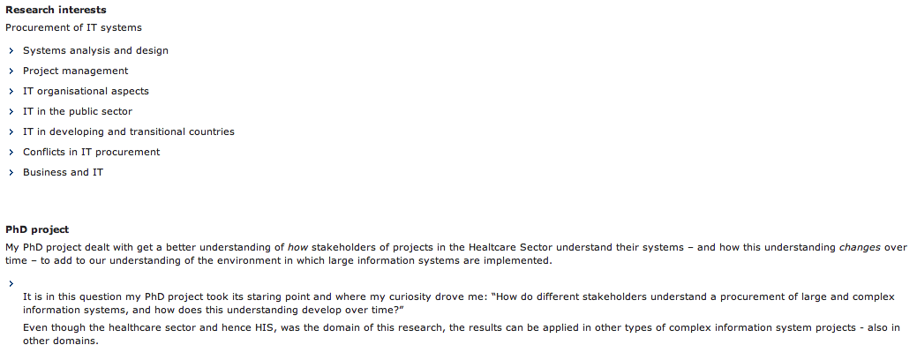
Bjarne Rerup Schlichter

Slide 4
From business IT value to public IT value : An action research study of healthcare in the Faroe Islands. / Svejvig, Per; Schleicher, Bjarne Rerup; Andersen, Povl Erik Rostgaard. 2012. Paper presented at The 7th Mediterranean Conference on Information Systems, Guimarães, Portugal
Interventions during the problem-solving cycle : An action research study of emergent benefit realization from healthcare enterprise information systems in the Faroe Islands. / Schlichter, Bjarne Rerup; Svejvig, Per; Andersen, Povl Erik Rostgaard. 2012. Paper presented at PRE-ICIS CONFERENCE ON ENTERPRISE SYSTEMS RESEARCH IN MIS, Orlando, United States.Paper
Dynamics of Trust in System Implementation : A longitudinal interpretive case study on the Faroe Islands. / Schlichter, Bjarne Rerup. Aarhus : Handelshøjskolen i Århus, 2011. 200 p. (PhD Thesis; No. 2011:6).Ph.d. thesis
Recovering from trust breakdowns in large system implementations. / Rerup Schlichter, Bjarne Rerup; Andersen, Povl Erik Rostgård. In: Journal of Information Technology Case and Application Research, Vol. 13, No. 2, 2011.Journal article
A comprehensive literature review of the ERP research field over a decade. / Schlichter, Bjarne Rerup; Jensen, Pernille Kræmmergaard. In: Journal of Enterprise Information Management, Vol. 23, No. 4, 2010, p. 486-520.Journal article
Development of trust during large scale system implementation. / Schlichter, Bjarne Rerup. In: Journals of Cases on Information Technology, Vol. 12, No. 2, 2010, p. 1-15.Journal article
Dynamic trust in implementation of large information systems - conceptualized by features from Giddens Theory of Modernity./ Schlichter, Bjarne Rerup. In: Systems, Signs & Actions, Vol. 4, No. 1, 2010, p. 1-22.Journal article
Recovering from trust breakdowns in large system Implementations. / Schlichter, Bjarne Rerup; Andersen, Povl Erik Rostgård. 2010. Paper presented at The Mediterranean Conference on Information Systems (MCIS) 2010, Tel Aviv, Israel.Paper
A comprehensive literature review of the ERP research field. / Schlichter, Bjarne Rerup; Jensen, Pernille Kræmmergaard. Aalborg : Aalborg Universitet, 2009.Working paper
Analyzing Trust Perceptions in System Implementations. / Schlichter, Bjarne Rerup; Rose, Jeremy. 4th Mediterranean Conference on Information Systems. ed. / A Pouloudi. 2009. p. 1241.Article in proceedings
Research Literature on ERP Systems : A Review of Research Domains and Issues. / Schlichter, Bjarne Rerup; Kræmmergaard, Pernille. 2008. Paper presented at 5th International Conference on Enterprise Systems, Accounting and Logistics 2008 (ICESAL 2008), Heraklion, Crete Island, Greece.Paper

Slide 5
Field work
Bajrne is IT consultant in the Faroe Islands working with automation of the health service
Implementation of Integrated Hospital Information System throughout the islands’ healthcare provision
Bjarne becomes researcher instead - converts to longitudinal field study
multiple source data collection strategy: participant observation, individual semi-structured interviews and document study
18 interviewees, six interview points, 50 interviews, general interview protocol not focused on trust but on project goals and progress

Slide 6
Theory base: Giddens late modernity
Constructs:
  Trust – in persons and in abstract systems.
  Time-space distanciation – the ability of a social system to function over time and space without the physical co-presence of its social actors, sustained by trust.
  Abstract system – dis-embedded social system trusted despite lack of detailed understanding or personal trust relations.
  Dis-embedding, re-embedding – processes where an abstract system is removed from immediate close contact, and temporarily made personal again.
  Access point – a point where a lay person makes contact with the abstract system.
  Chronic reflexion – constant evaluation of our social situation and actions (including the trustworthiness of people and abstract systems).
  Ontological security - confidence in the robustness and sustainability of self-identity and belief in the continuity of social practice, sustained by trust in people and abstract systems.

Slide 7
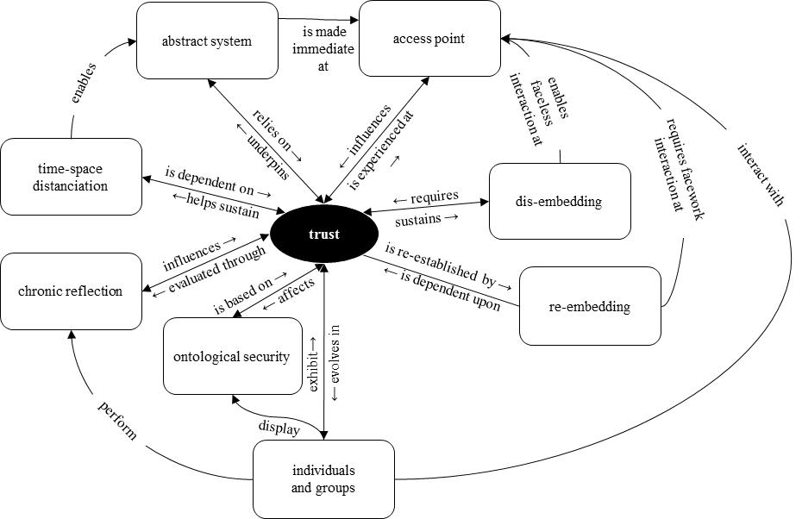
Construct relationships: trust model

Slide 8
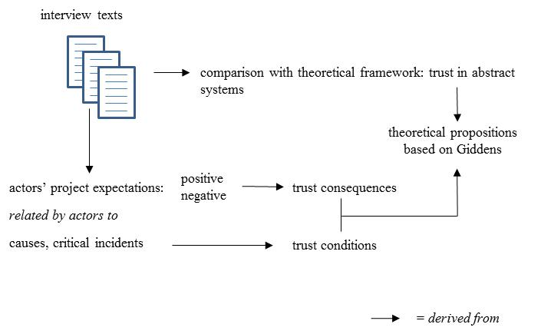
Overall research strategy

Slide 9
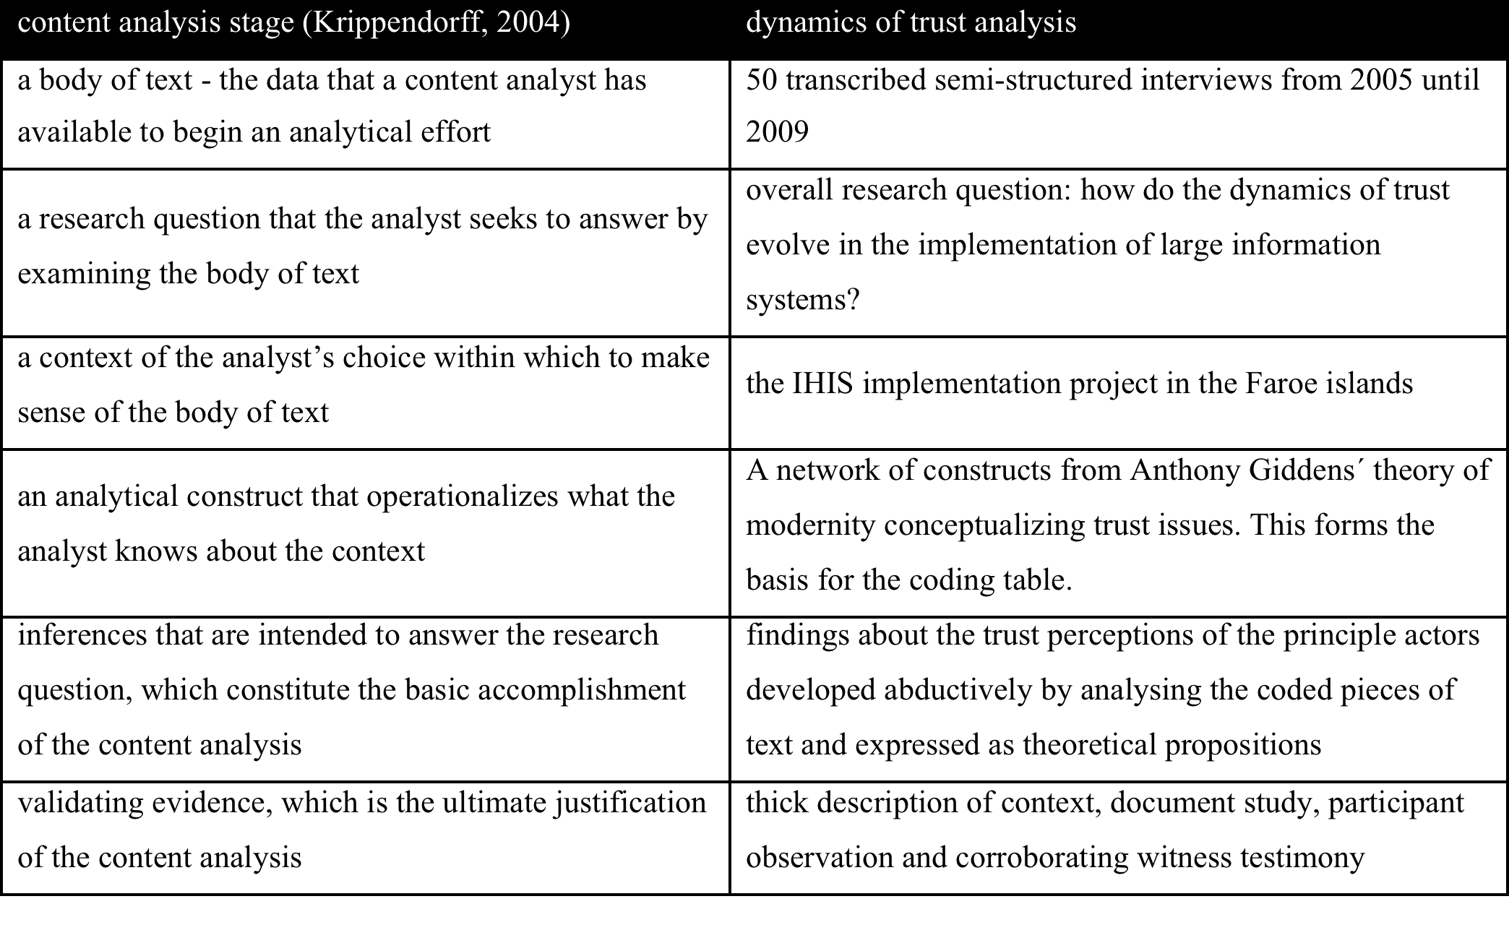
Data analysis, content analysis + critical incident technique

Slide 10
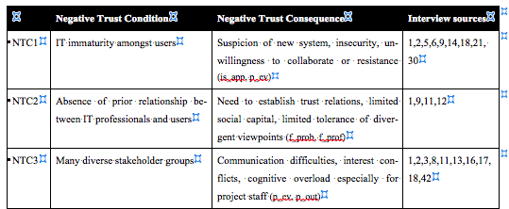
Findings grounded in data
Dissatisfaction (and some open resistance) expressed in much gossip amongst users began to mount, and was felt keenly by project staff (”we get a lot of we don’t know what we’re doing from the users – we haven’t understood what it’s about –we’re stupid – it’s a tough project for the project staff” [#31, project manager] ).

Slide 11
Difficulties in review
I recruited two senior scholars to act as reviewers for this paper. Both have reviewed the paper carefully and provided a wealth of feedback. Whilst both are complimentary of the potential contribution that can be made through this paper, both are also critical of numerous aspects of the paper, including it’s intended scope, it’s use of language (particularly an excess of jargon that make it impenetrable to a reader not familiar with the work of Giddens), the methods involved and the way the contribution is presented. I do not intend to highlight all of the reviewers’ excellent comments here – they speak for themselves very clearly. Given the importance of the topic, as well as the potential contribution that can be made, my decision is *not* to reject the current version of the paper outright. However, I do believe that substantial work needs to be done to organise the material in such a way that the contribution is clearer. I invite the authors to make major revisions to the paper – following the guidance of the reviewers. Given the magnitude of the changes, I will not guarantee that a future version of the paper can be accepted.

Slide 12
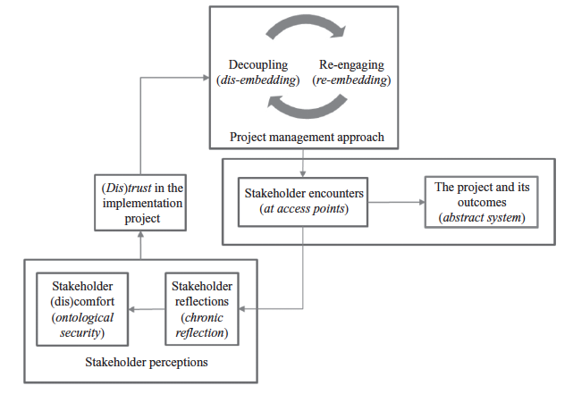
Generalization to theory 1: research model

Slide 13
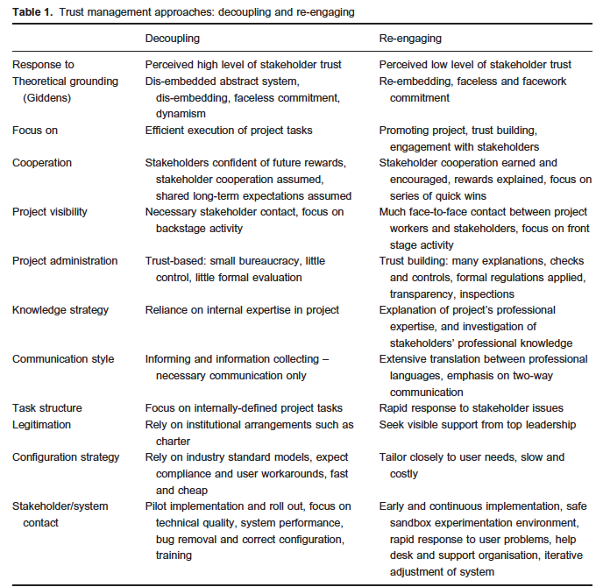
Generalization to theory 1: natural language theory

Slide 14
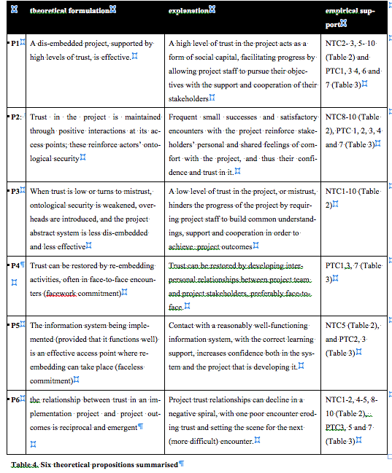
Generalization to theory 2: six propositions

