Slide 1
building theory in interpretive research
Publishing interpretive research

Slide 2
Seminar questions
What’s generalization, and why we you need it?
Is it harder to generalize for interpretivists?
What’s important theory in your field?
How is it expressed – in what form?
How is it constructed?
What are the goals of theory?
What kinds of theory are there – what can it do or generalize?
What are the structural components of theory
Where does theory come from?

Slide 3
On generalization
LEE, A. S. & BASKERVILLE, R. L. (2003) Generalizing generalizability in information systems research. Information Systems Research, 14, 221-243.
Generalization is the basis for which our work can be
  scientific
  of significance to others
A general assumption that positivism and associated statistical techniques improve generalizability
Statistical generalization: improved sample size improves reliability of sampling procedure
Hume: the problem of induction
  Generalization outside the setting (sample) or to a future time (prediction) is based on an inductive argument which can’t be justified in logic
Holds for both interpretive and positivist generalization

Slide 4
IS: theory
GREGOR, S. (2006) The nature of theory in information systems. MIS Quarterly, 30, 611-642.
Domain questions. What phenomena are of interest in the discipline? What are the core problems or topics of interest? What are the boundaries of the discipline?
Structural or ontological questions. What is theory? How is this term understood in the discipline? Of what is theory composed? What forms do contributions to knowledge take? How is theory expressed? What types of claims or statements can be made? What types of questions are addressed?
Epistemological questions. How is theory constructed? How can scientific knowledge be acquired? How is theory tested? What research methods can be used? What criteria are applied to judge the soundness and rigor of research methods?
Socio-political questions. How is the disciplinary knowledge understood by stakeholders against the backdrop of human affairs? Where and by whom has theory been developed? What are the history and sociology of theory evolution? Are scholars in the discipline in general agreement about current theories or do profound differences of opinion exist? How is knowledge applied? Is the knowledge expected to be relevant and useful in a practical sense? Are there social, ethical or political issues associated with the use of the disciplinary knowledge?

Slide 5
Theory goals
Analysis and description. The theory provides a description of the phenomena of interest, analysis of relationships among those constructs, the degree of generalizability in constructs and relationships and the boundaries within which relationships and observations hold.
Explanation. The theory provides an explanation of how, why and when things happened, relying on varying views of causality and methods for argumentation. This explanation will usually be intended to promote greater understanding or insights by others into the phenomena of interest.
Prediction. The theory states what will happen in the future if certain pre-conditions hold. The degree of certainty in the prediction is expected to be only approximate or probabilistic in IS.
Prescription. A special case of prediction exists where the theory provides a description of the method or structure or both for the construction of an artifact (akin to a “recipe”). The provision of the recipe implies that the recipe, if acted upon, will cause an artifact of a certain type to come into being.

Slide 6
Theory structural components
Common to all theories:
  Means of representation: The theory must be represented physically in some way: in words, mathematical terms, symbolic logic, diagrams, tables or graphically. Additional aids for representation could include pictures, models or prototype systems.
  Constructs: These refer to the phenomena of interest in the theory (Dubin’s “units”). All the primary constructs in the theory should be well defined. Many different types of constructs are possible: for example, observational (real) terms, theoretical (nominal) terms and collective terms.
  Statements of relationship: These show relationships among the constructs. Again, these may be of many types: associative, compositional, unidirectional, bi-directional, conditional, or causal. The nature of the relationship specified depends on the purpose of the theory. Very simple relationships can be specified: for example, “x is a member of class A”.
  Scope: The scope is specified by the degree of generality of the statements of relationships (signified by modal qualifiers such as “some”, “many”, “all”, “never”) and statements of boundaries showing the limits of generalizations.
Contingent on theory purpose:
  Causal explanations: The theory gives statements of relationships among phenomena that show causal reasoning (not covering law or probabilistic reasoning alone).
  Testable propositions (hypotheses): Statements of relationships between constructs are stated in such a form that they can be tested empirically.
  Prescriptive statements: Statements in the theory specify how people can accomplish something in practice, e.g., construct an artifact or develop a strategy.

Slide 7
Theory taxonomy
I. Analysis.
  Says “what is”. The theory does not extend beyond analysis and description. No causal relationships among phenomena are specified and no predictions are made.
II. Explanation.
  Says “what is”, “how”, “why”, “when”, “where”. The theory provides explanations but does not aim to predict with any precision. There are no testable propositions.
III. Prediction.
  Says “what is” and “what will be”. The theory provides predictions and has testable propositions but does not have well-developed justificatory causal explanations.
IV. Explanation and prediction (EP).
  Says “what is”, “how”, “why”, “when”, “where” and “what will be”. Provides predictions and has both testable propositions and causal explanations.
V. Design and action.
  Says “how to do something”. The theory gives explicit prescriptions (e.g., methods, techniques, principles of form and function) for constructing an artifact.

Slide 8
Where does theory come from?
Theory from theoretical argumentation, (positivism: development of hypotheses, empirical material provides reality test), often from existing theory (sometimes imported from another discipline)
Theory from data (grounded theory)
Theory from combined applications of theory and data
  e.g.: a model developed from theoretical argumentation is refined by data analysis

Slide 9
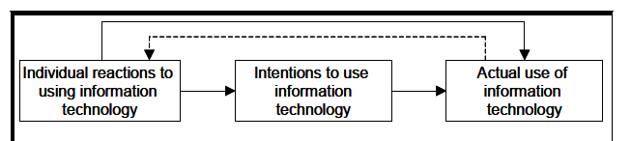
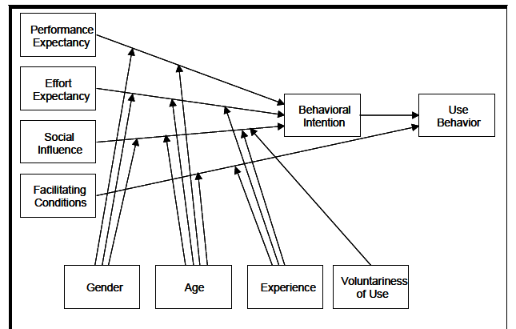
Positivism in IS: theory top down
Start with a primer theory
Simple model with independent and variable constructs (variables)
Construction of hypotheses
Measures and questionnaires
Empirical validation
Structural equation modeling
Facilitates cumulative theory building
Deductive reasoning strategy

Slide 10
Grounded theory (bottom-up)
Start with (qualitative) data rather than theory
Derive concepts (constructs) from data through some form of content analysis
Derive relationships for constructs
Concepts and their relationships represent generalizations, implying patterns in the data
Iterate with more data collection focused on developing theory (theoretical sampling)
‘theory denote a set of well-developed categories (themes, concepts) that are systematically interrelated through statements of relationship to form a theoretical framework that explains some phenomenon’ (Corbin + Strauss)
The Strauss/Glaser conflict
  Strauss: a well defined 'coding paradigm,’ always look systematically for 'causal conditions,' 'phenomena/context, intervening conditions, action strategies' and 'consequences' in the data
  Glaser: theoretical codes are employed as they emerge in the same way as substantive codes emerge, but drawing on a huge fund of 'coding families.'

Slide 11
‘Emergent’ theory-building
An initial theory (e.g. structuration theory)
Data collection (empirical material formation)
Analysis of data or case in relation to the theory
  For example content analysis
Revision of theory in relation to both theoretical and empirical findings
Some degree of iteration
Typical interpretive process – not well-described in the literature
Can be quite Straussian (the initial coding paradigm reflects the initial theory)

Slide 12
‘emergent’ theory building: problematization and counter-intuitive theory building
a gap in scientific knowledge is revealed by analysis of the state of the art in relevant theory - which generates a research question or problem
the theory is the answer or problem solution which fills the knowledge gap
the research problem: represents a mystery or concern in the theory or data, something which is poorly understood or un-expected
the theory that resolves the research problem: represents a new take, something which is different from current understandings expressed in previous relevant theory

Slide 13
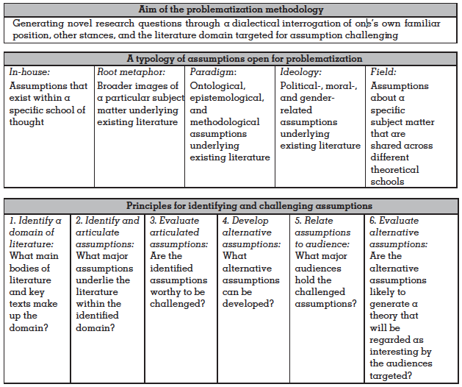
Problematization
ALVESSON, M. & SANDBERG, J. (2011) Generating research questions through problematization. Academy of Management Review, 36, 247-271.

Slide 14
Theory-building
ALVESSON, M. & KÄRREMAN, D. (2007) Constructing mystery: Empirical matters in theory development. Academy of Management Review, 32, 1265-1281.
Theories that fill gaps or confirm existing work are not necessarily interesting
We need
  research themes that can be empirically investigated, empirical material that carries some credibility, meaning that it is capable of offering clues for thinking and the making of claims and/or counterclaims, and
  ideas that offer challenges to conventional thinking within an area, pointing at shortcomings or paradoxes; this requires an intensive empirical material/theory interplay where theory is also used "negatively"- a significant resource is theory (models, vocabularies) that fails to be useful to account for a phenomenon, which does not imply a Popperian ideal of falsification but can be seen as a chance for problematization
  a reflexive approach to empirical material that encourages alternative constructions and the self-critical interpretations of one’s own paradigmatic, political, theoretical, methodological, and social predispositions.

Slide 15
Continued: Process
Familiarizing oneself with the study
Encountering/constructing breakdowns in understanding
Moving from breakdowns to ‘mystery’ by showing:
  the broader relevance of an empirical finding
  the problems with the earlier theory or critique
  some hints of a new understanding
Systematic work to generalize the new understanding to theory
  New concepts and relationships, systematic empirical analysis
Show how the new theory solves the ‘mystery’
Positioning it in relation to other relevant theories

