Slide 1
Interpretive research approaches
Publishing interpretive research

Slide 2
Seminar questions
What data collection and analysis techniques are available to qualitative researchers?
If you do qualitative research, are you therefore committed to an interpretive philosophical position?
What constitutes good interpretive research?
What’s the most important component of qualitative, interpretive research in relation to publishing well?
Which research approaches are traditionally associated with interpretivism?
How do you choose one for your own research?
Can you mix and match?

Slide 3
It’s qualitative: is it interpretive?
Qualitative data collection and analysis methods are appropriate for interpretive research
Data collection: field experiments and studies, some forms of lab experiments such as usability studies, interviews (often semi-structured), observation, participant observation, document and web-site study, many internet data collection strategies, diaries and logs, structured note-taking…..
Analysis strategies: content analysis, coding, causal mapping, repertoire grid technique, critical incident technique, discourse (conversation) analysis, narrative analysis, soft systems analysis, social network analysis……..
Analysis support tools, e.g. content analysis tools
Triangulation
Few of these strategies presuppose an interpretive philosophical position

Slide 4
What constitutes ‘good’ interpretive research?
KLEIN, H. & MYERS, M. (1999) A Set of Principles for Conducting and Evaluating Interpretive Field Studies in Information Systems. MIS Quarterly, 23, 67-93.
The hermeneutic circle
  asserts that human understanding is achieved by iterating between consideration of the independent meaning of the parts and the whole that they form
Contextualization
  requires critical reflection of the social and historical background of the research setting, so that the intended audience can see how the current situation under investigation emerged
Interaction between researchers and subjects
  requires critical reflection on how the research materials (or ‘data’) were socially constructed through the interaction between the researchers and participants
Abstraction and generalization
  requires relating the idiographic details revealed by the data interpretation to theoretical, general concepts that describe the nature of human understanding and social action
Dialogical reasoning
  requires sensitivity to possible contradictions between the theoretical preconceptions guiding the research design and actual findings (‘the story which the data tell’) with subsequent cycles of revision
Multiple interpretation
  requires sensitivity to possible differences in interpretations among the participants as are typically expressed in multiple narratives or stories of the same sequence of events under study
Suspicion
  requires sensitivity to possible biases and systematic distortions in the narratives collected from the participants

Slide 5
Which research approaches suit an interpretive philosophy?
Those approaches which allow for study of the subjective interpretations of research subjects, typically field studies
In IS:
  Case study
  Action research
  Ethnography
  ++ anything else that facilitates understanding of research subjects’ socially constructed meanings

Slide 6
Case study
CARROLL, J. M. & SWATMAN, P. A. (2000) Structured-case: a methodological framework for building theory in information systems research. European Journal of Information Systems, 9, 235-242.
Most typical: the narrative story, but,
  A case may be a person, group of people, organization, process or information system
Structured case includes:
  A conceptual framework
    Research themes
    Relevant literature
    Theoretical foundations or world-view: e.g. interpretivism, positivism
  An iterative research cycle
    Plan, collect data, analyze, reflect (includes theory-building)
  Literature-based scrutiny of the theory built
    The ‘enfolding’ literature
    Agreement and conflict with relevant theories

Slide 7
The interpretive case study
WALSHAM, G. (1995) Interpretive case studies in IS research: nature and method. European Journal of Information Systems, 4, 74-81.
First order social constructions (of the research subject), second order constructions (of the researcher)
Thick description – the consultable record
Engaged or non-engaged researcher(s)
Evidence from interviews (+ multiple contextual sources) which allows access to different interpretations of the phenomena studied
Careful reporting, such that the reader can reconstruct the findings of the researcher
The result: some form of generalization
  Development of concepts
  Development of theory
  Drawing of specific implications
  Contribution of rich insight

Slide 8
Action research: organizational intervention
A researcher engages in a change project in an organization (e.g. an IT development project) with two complementary ends: research, organizational change
The organizational setting normally requires the accommodation of different viewpoints or interpretations, hence the interpretive research philosophy
The research seeks theory as an explicit concern, and the tools, techniques, and models are linked to the research design
Emergent theory will emerge from both data and initial theory; theory building will be incremental and cyclic
Exploration of data and theory building should be explainable to others
History and context are given due weight
Dissemination of findings goes beyond those involved in a study

Slide 9
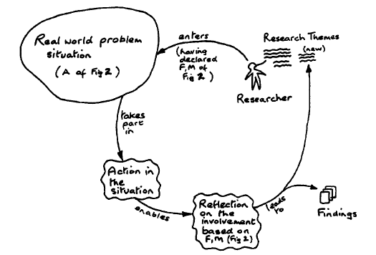
The Checkland criteria: recoverability
CHECKLAND, P. & HOLWELL, S. (1998) Action research: its nature and validity. Systemic Practice and Action Research, 11, 9-21.
A= application area
F = framework of ideas: (methodological), theoretical
M = intervention methodology

Slide 10
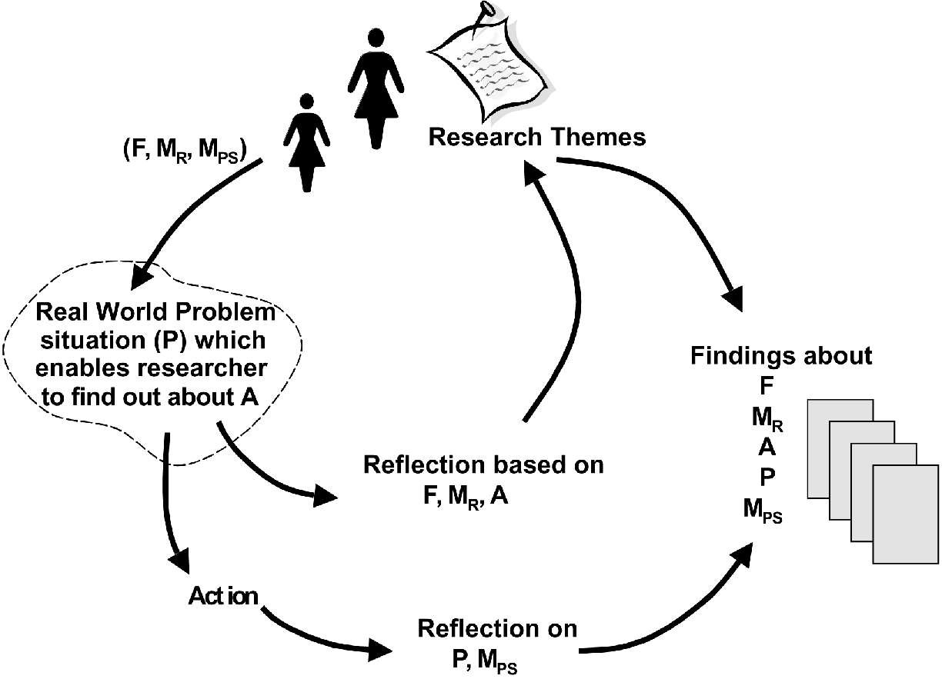
Action research: theory and practice
MCKAY, J. & MARSHALL, P. (2001) The dual imperatives of action research. Information Technology and People, 14, 46-59.
dual imperatives
  solving the problem
  conducting research
R = research
PS = problem solving

Slide 11
Action research forms
canonical action research
prototyping
soft systems methodology
action science
participant observation
action learning
multiview
ETHICS (by association other forms of participatory development)
clinical field work
process consultation
reflective systems development
collaborative practice research

Slide 12
Ethnography
MYERS, M. (1999) Investigating information systems with ethnographic research. Communications of the AIS, 2, 1.
Ethnographers immerse themselves in the life of people they study and seek to place the phenomena studied in their social and cultural context
Usual data-collection activities supplemented by participant observation, usually for longer periods
Detailed observational evidence
Deep rather than broad
Holistic school: ethnographer should ‘go native’ (empathize and identify with the research subjects
Semiotic school: instead analyze symbolic forms: words, images, institutions, behaviors forming webs of significance
Critical ethnography: exposes domination structures: hidden agendas, power centers, and assumptions that inhibit, repress, and constrain
Meticulous note-taking, analytical memos

Slide 13
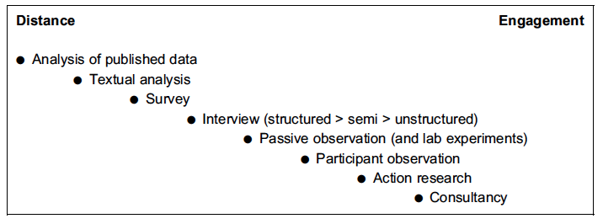
Choosing a research approach
NANDHAKUMAR, J. & JONES, M. (1997) Too close for comfort? Distance and engagement in interpretive information systems research. Information Systems Journal, 7, 109-131.
The philosophical position, data collection and analysis techniques may be rather similar – therefore the choice focuses around the depth of engagement sought

Slide 14
Mixing approaches
Make your reviewer comfortable
Choose a heading for your research approach which you are certain the reviewer will recognize
Mix and match data collection and analysis methods appropriately within your heading
Don’t mix philosophical positions (interpretivism, positivism) unless you really understand what you are doing
Exploit the ambiguity of qualitative research
  if you claim to be interpretive then you will be judged by these standards
  If you make no claims you will be judged by the standards of positivist research

