Slide 1
Interpretivism: philosophical roots
Publishing interpretive research

Slide 2
Seminar questions
What’s your discipline?
What are ontology and epistemology in relation to the philosophy of science and why are they important for your research?
What are the differences (O+E) between natural sciences and the social sciences?
What are the different philosophical approaches available to social scientists?
How are these positions simplified in the Information Systems field? In your field?
Which is the dominant position in IS? In your field?
What’s the relationship between philosophical positions and method?

Slide 3
My discipline: Information Systems (what’s yours)
A (North American) orthodoxy: positivism, but generally linked to some Popperian philosophy of science
Various alternatives or reactions, of which the most developed is (European) interpretivism
In IS the default assumption is positivism

Slide 4
A philosophy (of science) position includes:
Ontology: a set of assumptions about the nature of reality
Epistemology: a corresponding set of assumptions about the way you acquire knowledge
The philosophy of science has a long history: many positions available
Popper:
  science + pseudoscience
  reductionism, repeatability, refutation
Natural sciences have their positions: however we usually assume that we are social scientists
  The double hermeneutic (Giddens)

Slide 5
Classical social science philosophy (of science) positions
Blaikie: Approaches to Social Enquiry
Positivism (Comte)
  phenomenalism, nominalism, atomism, general laws, facts and value judgments, verification, regularities rather than causation
Critical Rationalism (Popper)
  conjectures, refutation, falsification, deductive logics, science and pseudo science
Classical hermeneutics (Schleiermacher, Dilthey, Husserl, Heidegger)
  Hermeneutic circle, verstehen rather than erklaren, lived experience, phenomenology, objects of consciousness, intentionality
Interpretivism (Weber, Schütz, Winch)
  Action and social action, subjective meaning, verstehen, social relationships, objective science of the subjective, language as the social medium, rule-following
Contemporary paradigms
  Critical theory (Habermas), ethnomethodology (Garfinkel), social realism (Baskhar), contemporary hermeneutics (Gadamer), structuration theory (Giddens), feminism, (postmodernism)

Slide 6
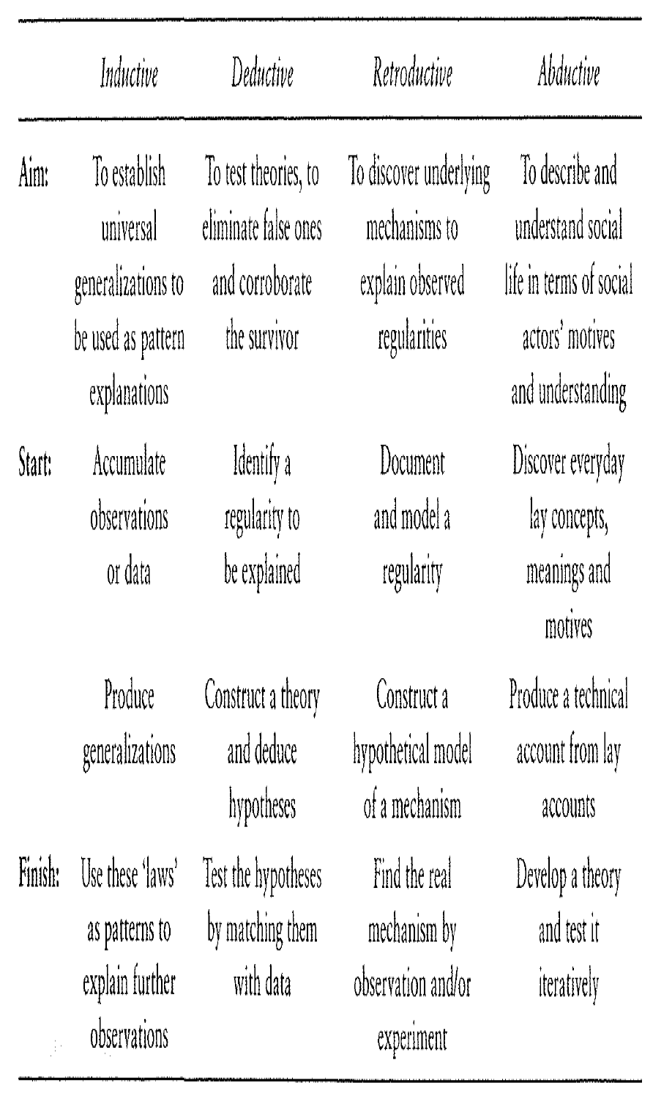
REASONING strategies (Blaikie)

Slide 7
IS positions
ORLIKOWSKI, W. J. & BAROUDI, J. J. (1991) Studying information technology in organizations: Research approaches and assumptions. Information systems research, 2, 1-28.
  Positivism
  Interpretivism
  Critical thinking

Slide 8
Positivism: ontology
The researcher and the object of inquiry are independent, and there is a sharp demarcation between observation reports and theory statements.
Nomothetic statements, i.e., law-like generalizations independent of time or context, are possible, implying that scientific concepts are precise, having fixed and invariant meanings.
There exist real, uni-directional cause-effect relationships that are capable of being identified and tested via hypothetic-deductive logic and analysis.
Inquiry is value-free

Slide 9
Positivism: epistemology
A search for universal laws or principles from which lower-level hypotheses may be deduced. Positivist researchers work in a deductive manner to discover unilateral, causal relationships, that are the basis of generalized knowledge; that is, that can predict patterns of behavior across situations
A tight coupling between explanation, prediction, and control. If an event or action is only explained when it can be deduced from certain principles and premises, then knowing the principles and premises beforehand enables prediction and control of the event or action
ORLIKOWSKI, W. J. & BAROUDI, J. J. (1991) Studying information technology in organizations: Research approaches and assumptions. Information systems research, 2, 1-28.

Slide 10
Interpretivism: ontology
A socially constructed reality made up of subjective meanings and socio-political as well as symbolic actions, which is produced and reinforced by humans through their action and interaction
Organizations, groups, social systems do not exist apart from humans, and hence cannot be apprehended, characterized, and measured in some objective or universal way
Therefore social realities cannot be ‘discovered’, only interpreted

Slide 11
Interpretivism: epistemology
Understanding social reality requires understanding how practices and meanings are formed and informed by the language and tacit norms shared by humans working towards some shared goal. Interpretive researchers construct interpretations or explanations that account for the way that subjective meanings are created and sustained in a particular setting
Such explanations are causal, but not in the positivists' uni-directional sense; neither are they sought for the same purpose. Interpretive researchers posit circular or reciprocally interacting models of causality, with the intention of understanding actors' views of their social world and their role in it

Slide 12
Critical thinking: ontology
social reality is historically constituted, and hence human beings, organizations, and societies are not confined to existing in a particular state. Everything possesses an unfulfilled potentiality, and people, by recognizing these possibilities, can act to change their material and social circumstances. Despite this belief, the critical perspective recognizes that the capacity to enact change is constrained, because humans become alienated from their potential by prevailing systems of economic, political, and cultural authority. In the light of this alienation, an important objective of critical research is to create awareness and understanding of the various forms of social domination, so that people can act to eliminate them.
Social reality is understood to be produced and reproduced by humans, but also as possessing objective properties which tend to dominate human experience. Because of the dialectical understanding of elements and the whole, as well as the belief in human potentiality, the critical research philosophy emphasizes the processual development of phenomena. Social relations are not posited as stable and orderly, but as constantly undergoing change

Slide 13
Critical thinking: epistemology
Knowledge is grounded in social and historical practices. There can be no theory-independent collection and interpretation of evidence to conclusively prove or disprove a theory. Because of the commitment to a processual view of phenomena, critical studies tend to be longitudinal
Generalizations stemming from this approach would point to regularities of process rather than to cross-sectional differences

Slide 14
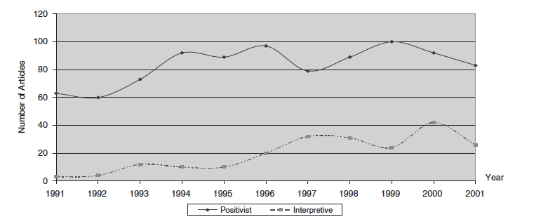
A dominant tradition in IS: positivism
CHEN, W. & HIRSCHHEIM, R. (2004) A paradigmatic and methodological examination of information systems research from 1991 to 2001. Information Systems Journal, 14, 197-235.
The only serious challenge to that tradition is interpretivism

Slide 15
One reason: dominant position of North American universities and journals
WALSHAM, G. (1995) The emergence of interpretivism in IS research. Information Systems Research, 6, 376-394.
Large English-speaking community, well-resourced, many universities
Tradition in top-journals, many journal editors
Editors are the guardians of scientific rigor - sometimes (mis)interpreted as positivism
Europeans and Scandinavians under-represented and therefore their traditions under-valued

Slide 16
Positivism and interpretivism summarized
Ontology
  positivists believe that reality exists objectively and independently from human experiences
  interpretivists emphasize the subjective meaning of the reality that is constructed and reconstructed through a human and social interaction process
Epistemology
  positivists are concerned with the hypothetic-deductive testability of theories. Scientific knowledge should allow verification or falsification and seek generalizable results. A causal relationship is usually presented and a tight coupling among explanation, prediction and control is expected
  interpretivists assume that scientific knowledge should be attained through the understanding of human and social interaction by which the subjective meaning of reality is constructed.

Slide 17
Orthogonal methodology
Positivist (typically): quantitative survey
Interpretivists (typically): field studies
However whereas ontology and epistemology need to be considered together…….
method is usually regarded as orthogonal to philosophical positions
  Few interpretive researchers conduct surveys, but there’s no real problem with collecting descriptive data this way
  The majority of field studies are (probably) positivist
Quantitative/qualitative orthogonal to positivist/interpretive

